Slide 1
4000+ Reboot & Win
3M PSD Gold Programme 2022, Channel Partner Toolkit

Slide 2



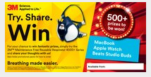
4000+ Reboot & Win
Division: Personal Safety Division
Activities and Tactics
Channel partner assets and tools
Earliest Go Live Date
English: June 2022
Local language: June 2022
Sell-in price promotion
10% promotional discount for stocking orders*
Sell-out promotion
3M provided prize-draw incentive to end-users who purchase a promotional pack & complete an online survey
Details will be included in all regular 4000+ SKUs
Channel Partner Inside Sales teams
Leverage activation pack & call script to target SMEs
Channel Partner Own Media
Use web banners provided for online shop
Leverage email assets to create a targeted campaign to SMEs
Paid Media
Use MDF budget to promote assets provided, targeting tradespeople e.g. local radio, press, social media
Channel Partner stores
Leverage in-store pack to position 4000+ next to adjacent products
Prize draw promotional flyer - included in product packaging
Print advert / catalogue page
Sticker for product packaging / in-store displays
Promotional leaflet (A4)
Shelf barker
Web banners (250 x 250, 600 x 300, 1200 x 600)
POS stand
Email asset pack (copy, images, subject lines)
Social media asset pack
Inside sales call script
Hero Product(s)
3M™ Maintenance Free Reusable Respirators 4000+ Series
Scope, Objective, Segment and Benefit
This programme aims to target small-to-medium sized businesses (SMEs), looking for reliable, comfortable & convenient respiratory protection with the 3M™ Maintenance Free Reusable Respirators 4000+ Series
Channel partners participating in the programme can expect to increase their sales by expanding the market for respiratory protection
4000+ is a consumable product, and repeat purchase will lead to sustainable new business
Sales Growth Target
Available Languages
3M end user demand creation programs
Initial Channel Partner Growth Target: $xxx
Suggested
MDF: $xxx
UK, DE, NL, FR, ES, IT, SE
*subject to change, depending upon market conditions

Slide 3
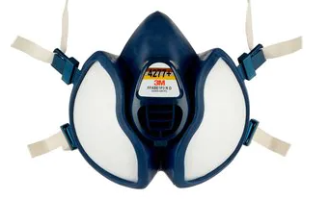
Benefits of activating this programme
3M estimates that approximately 58% of employees in EMEA who need to use a reusable respirator for work are not fully compliant.
“…in 2015, 17% of workers in the EU reported being exposed to chemical products or substances for at least a quarter of their working time…and 15 % report breathing in smoke, fumes, powder or dust at work”
- European Agency for Safety and Health at Work
Source: Employees needing & using RR data extracted from PSD market benchmarking tool. Data is sourced from external sources (i.e. employment statistics) and 3M internal assessments.
The 3M™ Maintenance Free Reusable Respirator 4000+ Series is an easy-to-use, convenient product that is an ideal solution to help improve compliance & grow the market for respiratory protection.

Slide 4
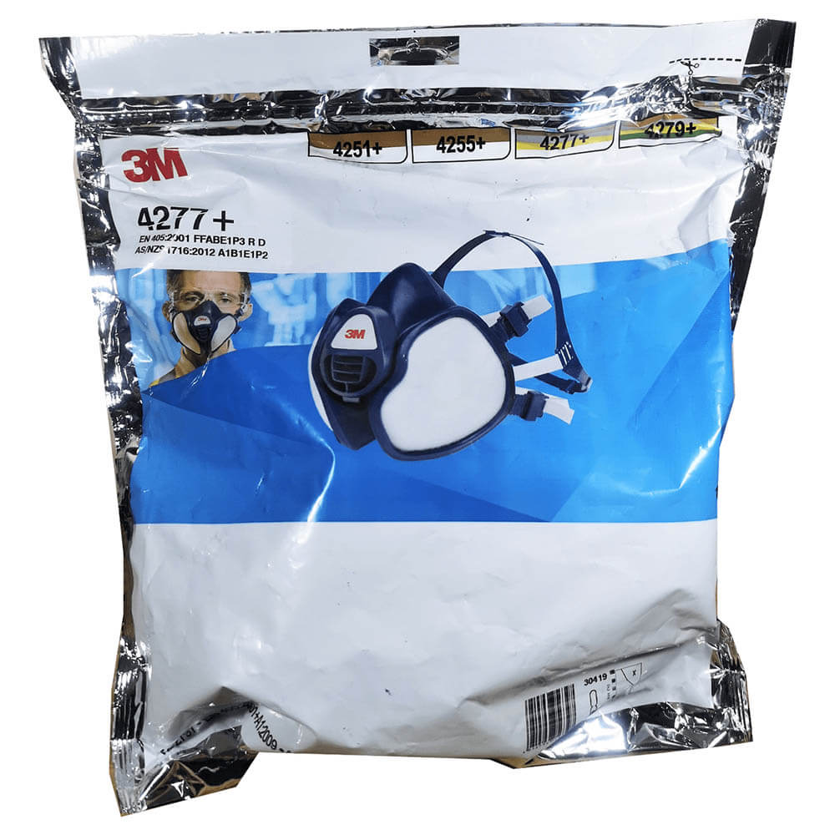

What makes the 4000+ better than other solutions?
Wear comfort
Soft and flexible face seal
Lightweight and well-balanced mask
Low-profile and ergonomic design for optimal field of vision
Easily adjustable straps for secure, comfortable fit
Breathing comfort
New enhanced valve assembly reduces breathing resistance by over 30%*
Designed with 3M’s electret particulate filter material to help achieve low breathing resistance
Convenient to use
Ready-to-use, maintenance-free construction with integrated filters
Designed to suit eyewear and hearing protection from 3M
Resealable bag provides convenient and clean storage between uses
*Exhalation breathing resistance of 3M™ 4000+ reduced by >30% for 120 lpm peak exhalation flow and >35% for 160 lpm compared to 3M™ 4000 Series. Results measured by 3M in 2017 under laboratory conditions. Breathing rates shown as an example only.
Sold as a case of 10 individual consumer packs which double as a storage bag to help prolong the life of the product.
The 3M™ Maintenance Free Reusable Respirator 4000+ Series helps to overcome some of the common objections to wearing RPE.

Slide 5




Target Audience
Small-to-medium sized enterprises
Companies without a dedicated Health & Safety Manager where the owner is purchasing respirators for up to approximately 10 employees, often including themselves
Typically have a lower compliance level than larger organisations – market growth opportunity
Work in a wide range of industries including construction, maintenance & repair, metal work and transportation.
This programme aims to access the target audience via:
eCommerce
Trade shops
Inside Sales
Notes:
905099

Slide 6







Campaign Architecture
-10%
3M provides sell-in price promotion & marketing assets
Activate marketing assets to target SMEs
3M Channel Partner
End User
Purchases product
Tries product
Enters the prize draw online by answering a few questions
3M hosts prize draw promotion
Details of how to enter are included within product packaging (May to November)

Slide 7

Countries & languages in scope
Countries in scope
End users residing in these countries are eligible for the prize draw:
Austria, Belgium, Denmark, Finland, France, Germany, Italy, Netherlands, Norway, Spain, Sweden, Switzerland, United Kingdom & Ireland
Languages available
Marketing assets are available in the following languages:
English, Dutch, French, German, Italian, Spanish, Swedish

Slide 8
Sell-in price promotion
Channel Partners participating in the programme qualify for a sell-in price promotion of -10% on standard net price.
-10%
Terms & conditions
The sell-in price promotion is available on orders placed between 1st June – 8th July 2022
The promotion applies to standard net prices only & is not available in conjunction with any existing deal prices
A maximum order volume will apply. This will be either 200% of the channel partner’s 2021 average monthly order volume or 200% of the channel partner’s agreed June 2022 forecast, whichever is higher
Channel partners must opt-in to the promotion by notifying their 3M Account Manager prior to the 13th April 2022
By opting into the promotion, the channel partner agrees to activate the end user prize draw promotion as described in this toolkit.

Slide 9

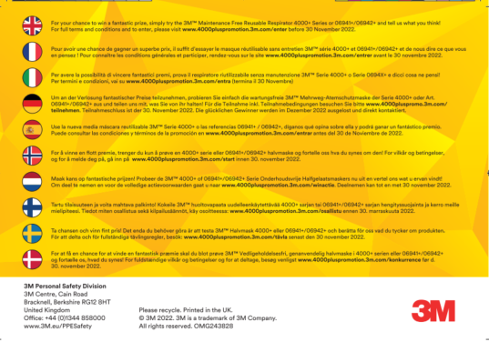
Promotional Packs
A double-sided promotional flyer will be included in the consumer pack level from late May until November 2022
The precise timing will depend upon the demand for the product & will be closely monitored. If you would like to check the status before placing an order please check with your 3M Account Manager
The 3M SAP & legacy SKU numbers will be unchanged during the promotion
The flyer includes some English & some local language text.

Slide 10
Prize Draw
The prize draw opens on the 1st June 2022 and closes on the 30th November 2022
The prize draw entries, selection of the winner & fulfilment of the prizes will be manged by 3M. Channel partners are not required to take any action
For full terms & conditions, please see - www.4000pluspromotion.3m.com/termsandconditions

Slide 11
Marketing Assets

Slide 12




Promotional leaflet
Suggested uses:
Direct mail to target customers
Make available in-store for customers to collect
Include within packaging when shipping associated products (e.g. abrasives or solvents)
Inside sales tool
DOWNLOAD
Tip: Click the white boxes to insert your own logo and the blue boxes to insert contact details
Also available with crop marks for printing

Slide 13
Print Advert
Suggested uses:
Seasonal catalogue page
In-store poster or countertop signage
DOWNLOAD
Tip: Click the white boxes to insert your own logo and the blue boxes to insert contact details
Also available with crop marks for printing

Slide 14


Web banners (250 x 250, 600 x 300, 1200 X 600)
Suggested uses:
Use as paid media
Host on eCommerce site – homepage or relevant product pages
DOWNLOAD
Tip: Click the white boxes to insert your own logo and the blue boxes to insert contact details
Also available as JPG files.

Slide 15
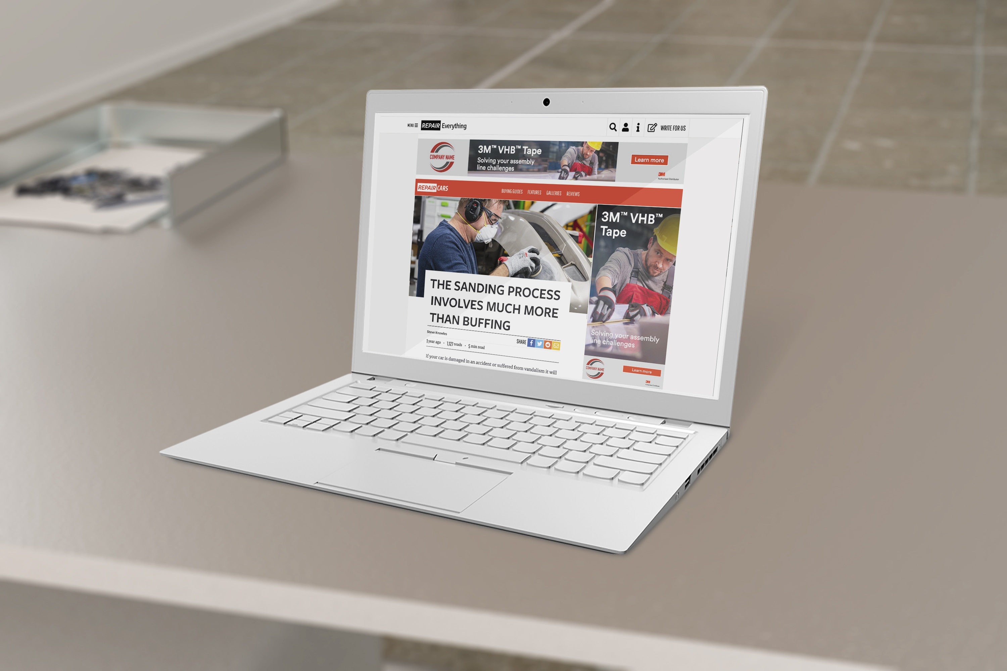
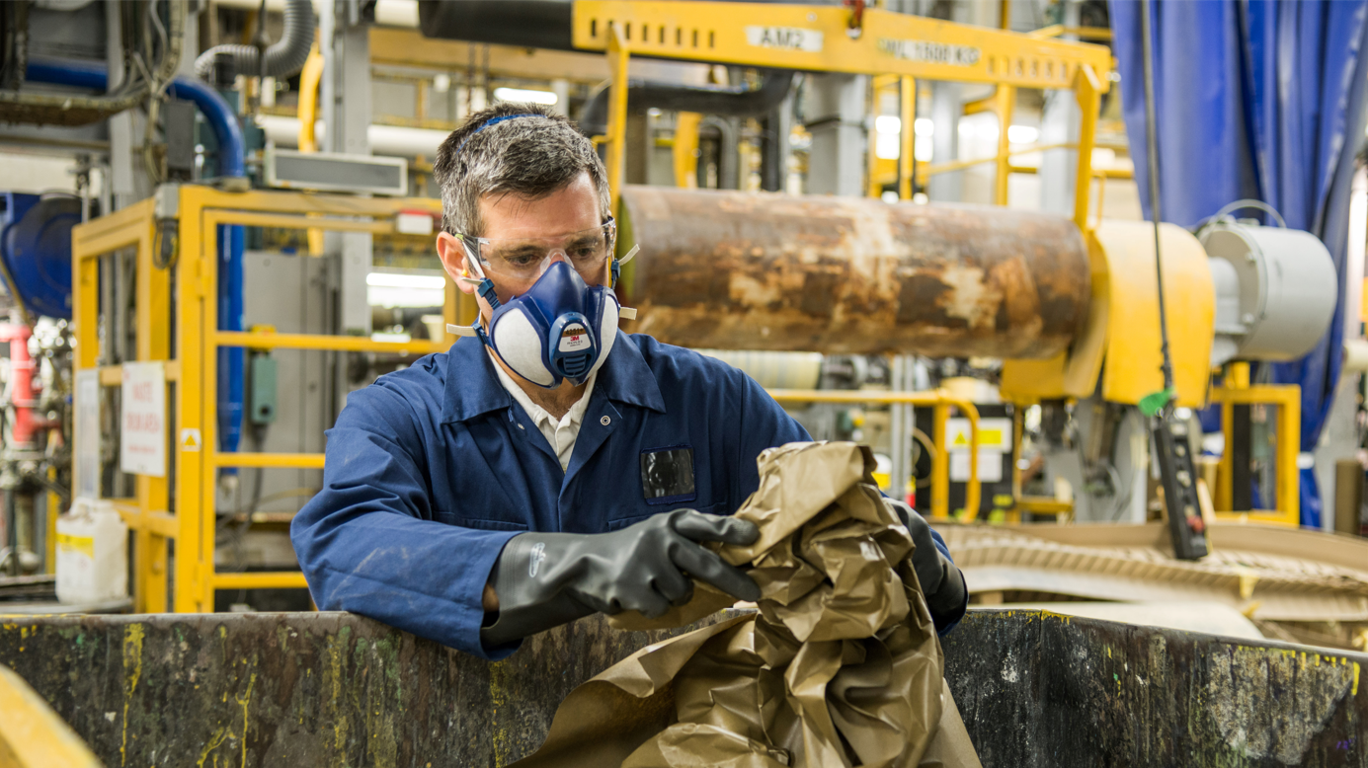
Email Asset Pack
A selection of product and application images are available for you to use in own channel partner emails.
Please refer to the 3M Channel Asset Generator to ensure branding compliance.
Suggested email text can be downloaded from the collection.
ACCESS COLLECTION

Slide 16
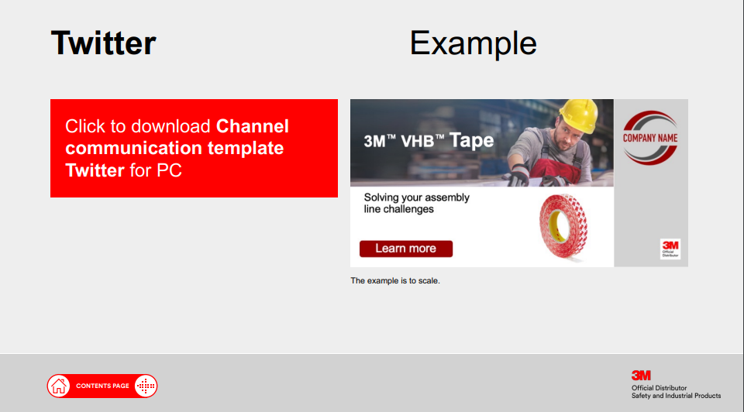
Social Media Asset Pack
A selection of product and application images are available for you to use in own channel partner emails.
Please refer to the 3M Channel Asset Generator to ensure branding compliance.
Suggested social media text can be downloaded from the collection.
ACCESS COLLECTION

Slide 17

Product Sticker
Suggested uses:
Apply to promotional packs used in in-store displays
DOWNLOAD

Slide 18

Shelf barker
Suggested uses:
Apply to shelving in in-store displays
DOWNLOAD

Slide 19
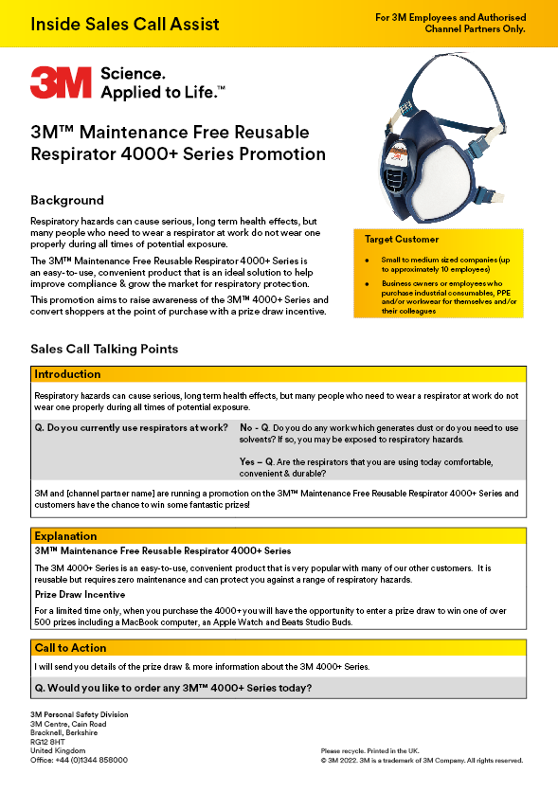
Inside Sales Call Script
A useful guide for 3M employees and channel partner sales teams with key points when talking with end users.
DOWNLOAD

Slide 20
Localised Assets
Assets are available to download from a dedicated assets collection link. If you require any assistance, contact your 3M representative.
EN (GB): http://gpimmediacollections.3m.com/dmrweb/servlet/Album?albumId=5820514
FR: http://gpimmediacollections.3m.com/dmrweb/servlet/Album?albumId=5821021
IT: http://gpimmediacollections.3m.com/dmrweb/servlet/Album?albumId=5821023
DE: http://gpimmediacollections.3m.com/dmrweb/servlet/Album?albumId=5821022
ES: http://gpimmediacollections.3m.com/dmrweb/servlet/Album?albumId=5821025
NL: http://gpimmediacollections.3m.com/dmrweb/servlet/Album?albumId=5821026
SE: http://gpimmediacollections.3m.com/dmrweb/servlet/Album?albumId=5820997

Slide 21
Timeline & Key Performance Indicators
2022
JAN | FEB | MAR | APR | MAY | JUN | JUL | AUG | SEP | OCT | NOV | DEC
Sell-in price promotion (10% discount)
Sell-out prize draw active
Prize draw marketing assets available
In-store displays available (POS displays, shelf barkers)
Some flexibility to timings may be possible. Please discuss any preferences with your account manager.
Suggested KPIs
Order value during promotional period
Sell-out value vs. previous years
Engagement (impressions, CTR etc.) with digital marketing assets
Number of stores deploying in-store marketing assets & store performance
Inside sales opportunities

Slide 22
Thank you.

