Slide 1
EU PPE Regulation 2016/425
23 May 2018

Slide 2
PPE Directive 89/686/EEC
Background
Originally published in 1989
Came into force in 1992
Directive = PPE Legislation for EU economics operators to follow each country transposed the directive into its own « national » law
EU economics operators = EU + Norway, Iceland & Lichenstein + Switzerland & Turkey due to « acquis communautaire »
Notes:
The PPE directive 89 slash 686 was established in 1989. A directive gives a common legislation for European countries to follow. However, each country transpose the directive into its own national law, each country has to translate it and fit it into its own national rules.
the countries from European union plus Norway, Iceland and Lichenstein. Also, Switzerland and Turkey are part of it due to acquis communautaire.

Slide 3
New PPE Regulation 2016/425
Single text throughout the EU
Specific legislation for all EU economics operators immediately applicable, no transposition in national law needed
EU economics operators = EU + Norway, Iceland & Lichenstein + Switzerland & Turkey
Notes:
Change from a Directive (89/686) to a Regulation (2016/425) = Simplification: no need of 28 national transposition acts; a single text throughout the EU for all the economic operators = Legal certainty: keep total harmonisation, avoid the risk of EU Member States to impose additional requirements
The PPE Regulation 2016 slash 425 was published in 2016 and the application will start on 21st of April 2018, with 1 year transition. A regulation set specific obligations for all European economics operators. The EU economics operators are the same as for the Directive.
The regulation offers a legal certainty compared to the directive. It gives a total harmonisation, therefore it avoids the risk of EU states to impose additional non harmonised requirements.

Slide 4
PPE Regulation 2016/425 Objectives
Make it easier to remove dangerous PPE from market
Improve traceability
Reinforced and more efficient market control
Clearer responsibilities for all actors in supply chain
Notes:
In few words, let’s look at the benefits that the new PPE Regulation will provide:
It will make it easier to remove dangerous products from the market, it will define clearer responsibilities for all parties, will Improve traceability, Reinforce controls, will create a more collaborative system for market surveillance and will Streamline procedures concerning notification of dangerous products

Slide 5
Major changes
01

Slide 6
Major Changes of PPE Regulation 2016/425
Changes to the scope
Risk categories defined, no more PPE categories
EU declaration of conformity to be easily accessible by Market Surveillance
Traceability requirements
Conformity assessment procedure more elaborate
Obligations of Economic Operators / Distributor Due Diligence
Market Surveillance Stricter
Stricter requirements for Notified Bodies
Transition

Slide 7
1. Changes to the Scope
Includes PPE for private use – e.g.: oven gloves
Distance selling products like “Online selling products” must comply
PPE for demonstration use do not require compliance if visible sign indicates “ does not comply to the regulation”
Notes:
In the PPE regulation, the scope has been enlarged. PPE for private use like oven gloves are now included for example.
The online selling products must comply to the regulation, even if they are made and sold from the US for example. And, PPE such as prototype, PPE for VOC or for trade shows do not require compliance as long as they have a visible sign to indicate “do not comply to the regulation”

Slide 8
2. Risk categories instead of PPE categories
CATEGORY I
Simple design
Minimal risks
CATEGORY II
Intermediate design
Risks other than Categories I & III
CATEGORY III
Complex design
Risks with very serious consequences
Technical documentation
EC EU type-examination – Article 10 – module B
Product testing
Article 11A
Module C2
Quality assurance system
Article 11B
Module D
XXXX
Notes:
With the PPE regulation, we now talk about risk categories instead of PPE category. Also, as a consequence, some PPE will now fall under risk category III such as earmuffs for harmful noise or special clothing for high pressure jets.
The article from the directive have been changes into modules. But all in all, there is no much difference except of the name. A PPE with the risk category 3 will still need to be “conformed” plus either have a yearly retest by the independent lab or have a quality system audit in place.
Nota Bene, under the directive, we talk about EC Type Examination and under the regulation, EU Type Examination. This is just for differentiation.

Slide 9
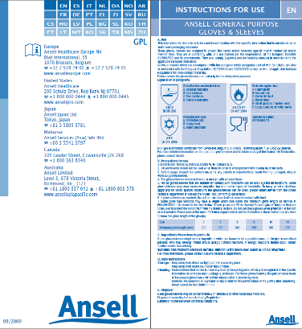
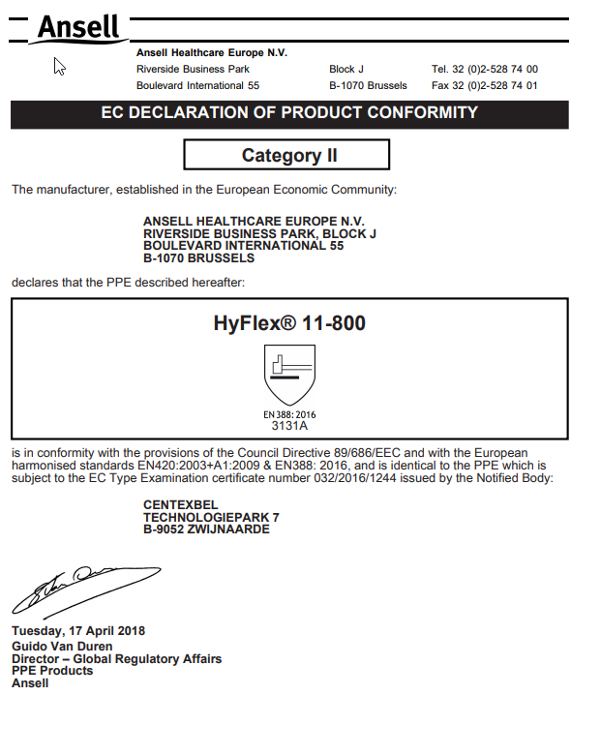
3. IFU & EU Declaration of Conformity accessibility
IFU must be with every 1st commercial packaging
Enclosed with PPE
OR
Internet address that gives an easy access to the DofC in the IFU
&
According to the directive, it was called EC Declaration of Conformity
Notes:
With the regulation, all PPE must be accompanied with the EU Declaration of Conformity in the relevant language, also called “D” “O” “C” or, if not with the product, the manufacturer has to include in the Instructions for Use the internet address where the EU DoC can be easily accessed.
Also the Economic operators must keep the technical documentation & the EU DoC for 10 years after the PPE has been placed on the market
----------------
Ansell will have to adapt and add a new weblink to have a very easy accessible way – or adapt with the existing Ansell.eu website

Slide 10
4. Traceability to be ensured by economic operators
Economic operators
Notes:
Ensure traceability throughout the whole supply chain, to help market surveillance simpler and more efficient, in their task to trace economic operators who made non-compliant PPE available in the market

Slide 11
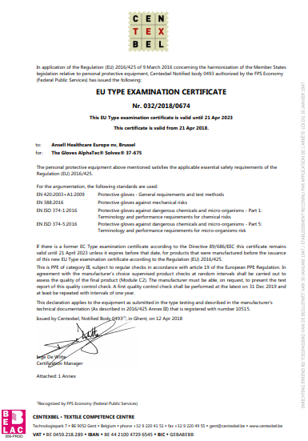
5. EU type-examination certificate & technical file
Must be kept 10 years
MANDATORY
even for
CAT I risk
According to the directive, it was called
EC type-examination
Mini technical file
5 YEARS VALIDITY
Notes:
EU type-examination certificate
Validity of the EU type-examination certificate limited to 5 years
Guarantee that PPE is always examined on the basis of the state of the art
PPE must then be recertified
Simplified procedure for renewal of the EU type-examination certificate where the manufacturer confirms that the approved type has not been modified

Slide 12
5. Claims substantiation
Need for a Risk Management process including reasonably foreseen conditions of end use
A more robust Quality System: “procedures in place for series of production to remain in conformity”, so more often and more strict. Example below:
Post Market Surveillance: complaint handling & recall procedures, active participation with market Control
 | Abrasion | Blade cut | Tear | Puncture | Impact Protection
EN 388 | Monthly to bi-monthly depending on lab capacity | Monthly to bi-monthly depending on lab capacity | Monthly to bi-monthly depending on lab capacity | Monthly to bi-monthly depending on lab capacity | Yearly (external tests)
Notes:
Still on the conformity part, some new procedure about risk management and claims substantiation.
A risk management process is needed for all products. In this risk management, we must foreseen conditions of the product usage. Let’s give you a couple of example to illustrate this:
If it is a janitorial glove, we should mention that it shouldn’t be used for food application.
If a glove is normed as per EN388 only, we should mention that it shouldn’t be used for heat application because the intended use was originally mechanical only and not thermal.
For better conformity, a more robust quality system should also be put into place to guarantee consistency of the product claims.
To finish on the conformity side, there will be a post market surveillance for recall. For any recall, all economics operators will be involved.

Slide 13
6. Obligations of economic operators
Manufacturer, Distributor & Importer intervening in the supply and distribution chain, should take appropriate actions to ensure the PPE is in conformity with the Regulations
Economic Operators
Manufacturer:
Any natural or legal person who manufactures PPE or has it designed or manufactured, and markets it under his name or trademark
Importer:
Means any natural or legal person established within the Union who places PPE from a third country on the Union market
Distributor:
Any natural or legal person in the supply chain, other than the manufacturer or the importer
Placing PPE on the market
Making available on the market

Slide 14
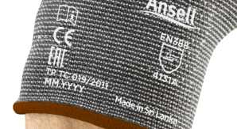
6. Manufacturers - Responsibilities
PPE needs to be safe + safe for the intended purpose & compliant
Procedures in place for series production to remain in conformity with the PPE Regulation
Shall take corrective actions in case of non compliance & inform the competent authorities where PPE presents a risk
Shall cooperate with authorities in a language which can be easily understood by that authority
Shall indicate on the PPE or packaging their name and postal address
Shall ensure PPE bears a type, batch or serial number MMYYXX
Notes:
Let’s firstly look at the manufacturer and importer due diligence. The usual apply, like PPE need to be safe for the intended purpose, be compliant to the market and always in conformity to the PPE Regulation.
In case of non compliance, manufacturers and importers should take corrective actions and inform the competent authorities in a language that can be easily understood.
Manufacturers and importers shall also indicates name and postal address on the PPE or on the packaging if not possible on the PPE. Ansell has usually the name “Ansell” and the postal address is on the Instruction for Use and U card of the inner packaging.
All PPE must have a type, batch or serial number. In Ansell, we will add the manufacturing month and year as per the picture on the slide.
Also part of the Manufacturers and Importers due diligence, Documents like technical sheet and Declaration of Conformity must be available, and kept for 10 years after placed in the market.
All products should be accompanied with the Instructions for Use and the EU Declaration of Conformity. If the Declaration of Conformity is not with the PPE, an easy accessible internet address should be on the IFU where the declaration can be accessed.
Talking about the Instruction for use, each first commercial packaging must be accompanied by the instructions for use. For example, Ansell vending pack have the U Card with all information since it is the smallest unit of vending.

Slide 15
6. Importer - Responsibilities
Shall place only compliant PPE on the market
Shall inform the competent authorities where PPE presents a risk
Shall cooperate with authorities in a language which can be easily understood by that authority
Shall not make PPE available in the market if the PPE is considered not to meet the essential health & safety requirements and, where needed, carry out sample testing
Shall ensure that transport & storage does not jeopardize the PPE’s conformity
Shall indicate on the PPE or packaging their name and postal address, if manufacturer is outside EU
Shall ensure the conformity assessment is carried out, the CE mark, the correct markings/claims & the EU declaration of conformity “EU DoC” is available
Shall ensure the PPE is accompanied with the Instructions for Use “IfU” in all languages

Slide 16
Distributors - Due Diligence
Shall act with due care and verify that the PPE bears the correct markings & is accompanied by the required documents in a language that can be easily understood by the consumers
Shall not make PPE available in the market if the PPE is considered not to meet the essential health & safety requirements
Shall ensure that transport & storage does not jeopardize the PPE’s conformity
Shall take corrective actions in case PPE is considered to be non compliant & inform the competent authorities in case PPE presents a risk, hence the “traceability requirement” - Ansell will ask distributors to sign contract to make sure they will firstly inform us before they recall our products
Shall cooperate with authorities & provide all the information necessary to demonstrate compliance
Notes:
Now, let’s talk about what the distributors must do. They have now more duties than before in term of conformity of the PPE. They must verify that the PPE bears the correct markings and is accompanied by the required documents in a language that can be easily understood by the consumers.
They shall ensure that transport and storage does not jeopardize the PPE’s conformity.
Distributors must have a traceability procedure in place, take corrective actions in case the PPE is considered to be non compliant and inform the competent authorities in case PPE presents a risk. On that topic, Ansell will ask our distributors to sign agreement to inform us before they recall an Ansell product, to make sure we are aware of it.

Slide 17
7. Market Surveillance Stricter
Programs in place to ensure effective measures are taken and continuously assessed
Improve cooperation between authorities, notified bodies & Economic Operators
Commission to be informed periodically together with proof of areas of competence
Establish adequate procedures to follow complaints & verify if corrective actions are taken
Measure taken
Assessment
Assessment
Measure taken
Notes:
Regarding market surveillance, a better cooperation between authorities, notified bodies and economic operators must happen. Programmes to be installed to ensure effective measures are taken and continuously assessed, also to follow up complaints and verify if corrective actions are taken.
The comission should be informed periodically with proof of areas of competence.

Slide 18
8. Notified bodies
Notified Bodies should “renotified”
Attendance of Coordination meetings
Active participation in round robin tests
Participation in standardisation activities
Notified Bodies shall take full responsibility for the tasks performed by subcontractors, with agreement of the client
Example with Centexbel & EN 511 or impact protection
Notes:
Let’s now talk about Notified Bodies. Firstly, they shall be a third party, located in the EU and must be independent of the organisation for which the PPE is assessed. They should attend Coordination meetings, be active in the participation in round robin tests, which means doing same tests of same product in different labs to compare results, to make sure they are performed the same way.
Notified bodies should also help in the standardisation activities and they must apply the Recommendations for Use.
Last, Notified Bodies shall take full responsibilty for the tasks performed by subcontractors, with agreement of the client. In another words, they should ask us first before they have the test being perfomed by a subcontractor
*** some notified bodies did not or will not carry on, due to the “renotification” with more constraint

Slide 19
9. Transition
Regulation applies from 21 April 2018 with one year transition
All new products must comply after 21 Apr 2019 (PPE Directive is repealed as of that date)
Certificates based on old PPE Directive remain valid until 21 April 2023 or sooner
31/03/2016
Publication Regulation
(EU)2016/425
21/04/2018
Regulation 2016/425
applies
21/04/2019
Obligations of Directive 89/686 end
21/04/2023
End of EC type examination certificates based on 89/686
2016
2018
2019
2023
21/04/2018 – 21/04/2019
Transition period: both 89/686 and 2016/425 are possible

Slide 20
Ansell Actions
02

Slide 21
Ansell Actions to ensure effective Compliance
Inform & train business
Complete certification of PPE portfolio to Regulation & latest EN standards, before 21st April 2019. Recertification of all PPE at least every 5 years
PPE markings & Instructions for Use to be renewed to the latest state of the art standards & regulations, prior to 21st April 2019
EU declaration of conformity to be updated and to be easily accessible through a dedicated web-link: www.Ansell.com/regulatory
Robust internal traceability system in place to allow efficient complaint handling or recalls
Contract between distributors & Ansell about transparency and recall of products
Notes:
whilst RA has worked with Legal to develop amendments to our supply contracts (General Conditions), outlining their responsibilities. Contracts now define the distributor’s responsibilities as defined above and by the new regulation, including the requirement to contact Ansell prior to make any decisions for recalling our products from the market.
Contract also stipulates they will also require written approval from Ansell in case they want to alter our products (e.g. adding a label, adding an additional cuff to our gloves or an additional pocket on our suits, etc.)

Slide 22
Ansell Actions to ensure effective Compliance
7. Claim substantiation: Demonstrate effective compliance through a robust QA management system & claim substantiation process
Regular lab testing of claimed performance. Examples for mechanical and chemical:
*Ansell will adapt depending on results, consistency, amount of production etc
8. Stock management: finish with slow moving stock prior to 21 April 2023
New products to be certified and marked to the new regulation & latest standards as of latest 21 April 2019
 | Abrasion | Blade cut | Tear | Puncture | Impact Protection
EN 388 | Monthly to bi-monthly depending on lab capacity | Monthly to bi-monthly depending on lab capacity | Monthly to bi-monthly depending on lab capacity | Monthly to bi-monthly depending on lab capacity | Yearly (external tests)
 | Leak test (water or air or validated equivalent) |  | Permeation
EN 374 | Every lot (AQL, as specified in product specs) |  | Quarterly for each claimed EN ISO 374:2016 chemical

Slide 23
Follow up evolutions related to Brexit
BSI for example, will have a “legal entity” in The Netherlands to make sure they can still certify products according to the European regulation even if the testing facility will remain in the UK
Ansell Hull in UK for BP products: if Hull becomes “out of EU”, then we would need an importer OR move this legal entity for BP products to another place, for example Trelleborg/Malmo

